Slide 1
Colorado Republican House Minority Team
“Lunch and Learn” Presentation: January 22, 2025
Purpose. To Answer Why An Article V Convention Is Necessary, Review Current Status, and Present Mission, Primary Goals, and Strategies
Agenda.
Why An Article V Convention is Necessary
Level of Trust in the Federal Government
Recent Polling Trend
Colorado Petition Overview
Current Status
General Process
Article V Convention Progress Map
COSA Mission and Primary Goals
Other Potential Strategies

Slide 2
Why An Article V Convention is Necessary
The federal government is broken!
The federal government continues to bankrupt this nation, embezzle the legitimate authority of the states, and destroy the liberty of the people.
Engaged in four major abuses which amount to a "soft tyranny":
Spending & Debt Crisis
Regulatory Crisis
Congressional Attacks on State Sovereignty
Federal Take-over of the Decision Making Process
It will never relinquish power on its own. A political force and authority outside of Washington must intervene to make necessary changes.
Article V of the US Constitution established that political force-We The People- and gives it the authority to make those changes!

Slide 3
Level of Trust in the Federal Government
(Why An Article V Convention is Necessary)
Vast Majority of Colorado Citizens do not trust the Federal Government
Consistent with the National Trend. Strong indication the Federal Government has too much power & leads to distrust
Article V Convention limits the power of the Federal Government
Article V Convention is a feasible solution to help re-build trust between Colorado Citizens and the Federal Government
After 9/11 Attacks
See Page 2 of Handout

Slide 4
Recent Polling Trend
(Why An Article V Convention is Necessary)
Conducted by Trafalgar Group
Conducted by Susquehanna Polling and Research (SP&R)

Slide 5
Colorado Petition Overview
(Why An Article V Convention is Necessary)

Slide 6
General Process
(Current Status)
1
2
3
Commissioner Selection
Article V Convention
Application Process
Article V explains: “on the Application of the Legislatures of two thirds of the several States, shall call a Convention for proposing Amendments”
34 of 50 states needed
19 applications thus far
Each State elects commissioners
States send as many as desired
“Equality of States” rule; 1-state, 1-vote
Commissioners propose, debate, and vote on amendments
Proposed amendments pass by majority of states
4
The Article V Convention has a 3-part platform:
Impose fiscal restraints on the federal government
Limit the power and jurisdiction of the federal government
Limit the terms of office for federal officials and members of Congress
Ratification
Three fourths of the several states must pass for an amendment to be ratified
38 of 50 states needed
Applies to each individual amendment

Slide 7
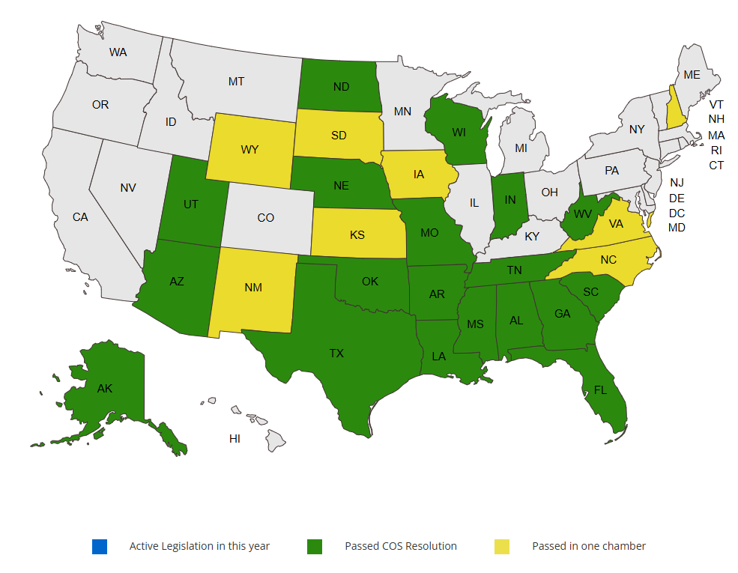
Article V Convention Progress Map
(Current Status)
Timeframe of 19 States Passing Article V Convention Resolution
Source: https://conventionofstates.com/ (see Progress Map at bottom of page links)
Georgia: March 6, 2014 Alaska: April 19, 2014 Florida: April 21, 2014 Alabama: May 22, 2015 Tennessee: February 4, 2016
Indiana: February 29, 2016 Oklahoma: April 25, 2016 Louisiana: May 25, 2016 Arizona: March 13, 2017 North Dakota: March 24, 2017
Texas: May 4, 2017 Missouri: May 12, 2017 Arkansas: February 14, 2019 Utah: March 5, 2019 Mississippi: March 27, 2019
Wisconsin: January 25, 2022 Nebraska: January 28, 2022 West Virginia: March 4, 2022 South Carolina: March 29, 2022

Slide 8
COSA Mission and Primary Goals
COSA Mission. Build a Strong, Engaged Army of Self-Governing Activists
2025 Primary Goals. To continue to advocate for passage of the COS Resolution in the Colorado State Legislature at the appropriate time.
To build better relationships with State Legislators by supporting their priorities that align with the principles of F3 (Federalism, Freedom, Fundamental Rights).
Federalism: idea of reducing federal power and increasing state sovereignty (e.g., increase state legislative power)
Freedom: idea of enabling key freedoms like maintaining election integrity
Fundamental Rights: idea of protecting fundamental rights like parenting
Grassroots volunteers engaging directly with their State Legislators

Slide 9
Other Potential Strategies
Ready 34 Legislation: Delegate Limitations Act
Formal legislation that dictates how delegates are selected
Sets limitations of delegates during Article V Convention
Colorado Joint Resolutions: Bypassing the Committee
Not required to be referred to committee; discretion of House Speaker
Example includes 2017 Article V Convention application for Term Limits for Congress; led by former State Senator Kevin Lundberg
Colorado Legislative Rules (November 2024), pages 18-20
House Minority allowed 4 joint resolutions; Article V Convention application can be one of them
What is the feedback from the Republican House Minority Team?

Slide 10
Back-up Slides
To assist with potential questions

Slide 11
General Highlights of 19 States’ Applications
(Current Status)
All 19 States incorporate standard 3-part platform; below are specific highlights from some of the applications
Term Limits for Members of Congress
Arizona will not allow its delegates to support term limits under 12 years
Mississippi will not support term limits of any kind; 2-part platform only
7 states provide general instructions for delegates
5 states mention general limitations and powers of Congress related to Article V Convention
5 states include “by definition, a Convention of the States means one-state, one-vote”
4 states explain application is not valid to make changes to the “Bill of Rights”
4 states recommend Congress determine the mode of ratification by state legislatures
1 state recommends Congress determine mode of ratification (either by state legislature or state convention) prior to convention

Slide 12
Case for Congressional Term Limits Amendment (1 of 4)
Potential Amendment Language.
Section 1: No person may serve more than eighteen years as a Member of Congress, whether such service is exclusively in the House or the Senate or combined in both chambers.
Section 2: Upon ratification of this article, any incumbent Member of Congress whose term exceeds the eighteenth year limit shall complete the current term, but thereafter shall be ineligible for further service as a Member of Congress.
Section 3: This amendment shall take effect in the third year after its ratification.

Slide 13
Case for Congressional Term Limits Amendment (2 of 4)
Original Intent (Articles of Confederation)
2nd Paragraph, Article V
“No person shall be capable of being a delegate for more than three years in any term of six years…”
“nor shall any person, being a delegate…receive any salary…”
Delegates faced term limits and were not paid
Election Incumbency
Since 1950’s, U.S. House Representatives sought re-election 85-93% of the time (high desire to remain)
Since 1950’s, U.S. House Representatives won re-election 88-97% of the time (high success rate)
Almost impossible to be voted out of office

Slide 14
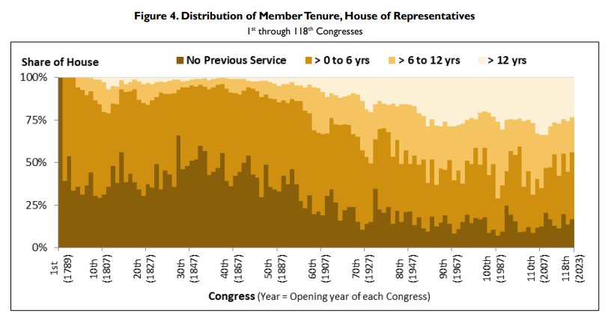
Case for Congressional Term Limits Amendment (3 of 4)
More Career Politicians

Slide 15
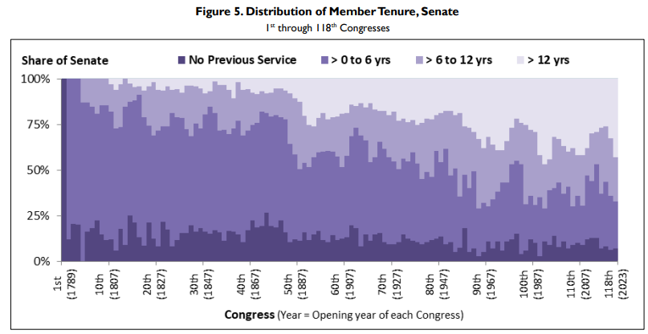
Case for Congressional Term Limits Amendment (4 of 4)
More Career Politicians

Slide 16
Case for Federal Budget Timeline Amendment (1 of 3)
Potential Amendment Language.
Section 1: The fiscal year begins on October 1st of a given year, and it concludes on September 30th of the following year.
Section 2: The annual budget process begins with Congress, and a complete fiscal year budget consists of a full resolution with all applicable appropriations. Congress shall adopt a complete fiscal year budget no later than the first Monday in May for the following fiscal year, and it shall submit the budget to the President for consideration.
Section 3: If Congress fails to adopt a complete fiscal year budget and the President fails to sign the budget into law prior to the start of a new fiscal year, then the previous fiscal year’s budget conditions automatically continue into the new fiscal year. On October 1, Congress shall assemble and remain in session until adopting a complete fiscal year budget and signed into law by the President. No other form of legislation will be permitted until after a complete fiscal year budget becomes law.
Section 4: This amendment shall take effect in the third fiscal year after its ratification.

Slide 17
Case for Federal Budget Timeline Amendment (2 of 3)
History of Budget and Impoundment Control Act (ICA)
Passed in 1974; established modern fiscal year from October 1 to September 30
First full fiscal year started in 1977; only three years of full budget resolution and all appropriations passed on time
1989, 1995, 1997
3 of 48 years or 6.25% of the time

Slide 18
Case for Federal Budget Timeline Amendment (3 of 3)

Slide 19
Case for Balanced Budget Amendment (1 of 5)
Potential Amendment Language.
Section 1: Total federal outlays shall not exceed total federal receipts for each fiscal year. Total federal outlays shall include all outlays of the United States, including those for repayment on federal debt principal plus interest. Total receipts shall include all receipts of the United States except that derived from borrowing.
Section 2: At least five percent of any fiscal year budget shall be applied to the outstanding federal debt principal plus interest.
Section 3: Congress, whenever three fifths of both chambers by roll call deem it necessary, may allow outlays to exceed receipts in section one for one fiscal year by borrowing in accordance with the second clause of section eight of Article One of this Constitution.
Section 4: Congress, whenever three fifths of both chambers by roll call deem it necessary, may vote to raise Taxes, Duties, Imposts, or Excises to increase receipts for one fiscal year in accordance with the first clause of section eight of Article One of this Constitution.
Section 5: This amendment shall take effect in the third fiscal year after its ratification.

Slide 20
Case for Balanced Budget Amendment (2 of 5)

Slide 21
Case for Balanced Budget Amendment (3 of 5)

Slide 22
Case for Balanced Budget Amendment (4 of 5)
By 1982, 40 states filed an Article V Convention application for a BBA
Congress attempted to create a BBA in lieu of convention; not able to get the job done
Common Theme: “total outlays do not exceed total receipts”

Slide 23
Case for Balanced Budget Amendment (5 of 5)
Supermajority Rule Balance Point (or Optimal Point)
Three Common Options: 3/5, 2/3, 3/4
What is the balance point between “Hold-up Minimization” and “Minority Protection”?
3/5
Hold-up Minimization
(Ability to prevent delays in legislation moving forward due to lack of enough required votes)
Minority Protection
(Ability to protect a smaller group from dominance by a larger group with respect to legislative interests)

Slide 24
Colorado Ratifying Plan (version 1.1)
1
2
3
Article V Convention
U.S. Congress Review
Colorado Statute Passed
History of 21st Amendment
Only amendment ratified by state conventions
Repeal of 18th Amendment; states determine any limitations of alcohol
“truly registered the will of the American people on a great national issue”
Colorado became 24th of 36 states needed to ratify
15 delegates elected by state wide ballot
Held September 26, 1933
Held in Senate Chamber
90 minutes long
5-8 Proposed Amendments
Mode of Ratification: State Conventions
Timeframe for Ratification: 7 years
Review proposed amendments
Send to states for ratification
Set dates and location for convention
Establish election procedure for convention delegates
4
5
Statewide Election
State Convention
100s of eligible citizens register in each Colorado Senate District (SD)
Five citizens from each SD randomly chosen
Voters select 1 of 5 citizens on ballot to become delegate
Total of 35 delegates voted to convention
~Two Weeks in Duration
Follow Mason’s Manual of Legislative Procedures
Elect Convention Leadership
Examine 5-8 Proposed Amendments
18 of 35 Delegates needed to ratify a single amendment
Vote on each amendment separately

Slide 25
Historical Passage of 13th Amendment
Government Element | Vote Summary | Timeframe
U.S. Senate | 38 (86%) – Yes, 6 (14%) – No Note: 6 did not vote | April 8, 1864
U.S. House of Representatives (1st Attempt) | 93 (59%) – Yes, 65 (41%) - No Note: 23 did not vote | June 15, 1864
U.S. House of Representatives (2nd Attempt) | 119 (68%), 56 (32%) – No Note: 8 did not vote | January 31, 1865
1. IL – Feb 1 | 9. ME – Feb 7 | 17. MN – Feb 23 | 25. AL – Dec 2 | 29. CA – Dec 19, 1865
2. RI – Feb 2 | 10. KS – Feb 7 | 18. WI – Feb 24 | 26. NC – Dec 4 | 30. FL – Dec 28, 1865
3. MI – Feb 3 | 11. MA – Feb 7 | 19. VT – Mar 8 | 27. GA – Dec 6 | 31. IA – Jan 15, 1866
4. MD – Feb 3 | 12. VA – Feb 9 | 20. TN – Apr 7 | By Dec 6, 1865, 27 of 36 states (or 75%) ratified the 13th Amendment. It was officially in the Constitution. | 32. NJ – Jan 23, 1866
5. NY – Feb 3 | 13. OH – Feb 10 | 21. AR – Apr 14 |  | 33. TX – Feb 18, 1870
6. PA – Feb 3 | 14. IN – Feb 13 | 22. CT – May 4 |  | 34. DE – Feb 12, 1901
7. WV – Feb 3 | 15. NV – Feb 16 | 23. NH – Jul 1 |  | 35. KY – Mar 18, 1976
8. MO – Feb 6 | 16. LA – Feb 17 | 24. SC – Nov 13 | 28. OR – Dec 8, 1865 | 36. MS – Mar 16, 1995
- Border State
- Confederate State
Note: both were slave states

