Slide 1
Capitol Building Maps and Rules
2022 Legislative Session

Slide 2
Capitol Area Parking Map

Slide 3
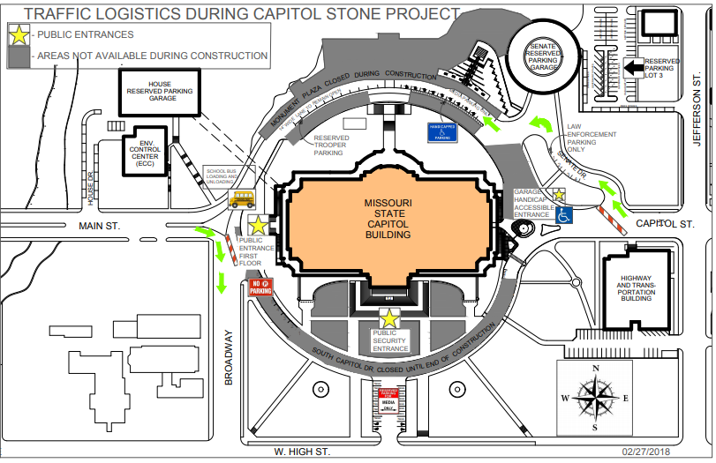

Slide 4
Entering the Capitol
Parking
Capitol Plaza Lots
Madison Street Garage
Handicapped accessible parking in North Circle
Traffic moves counterclockwise around Capitol building
Entrances
South and West entrances open
ADA accessible entrance East Garage
All entrances have security and public must pass through magnetometers

Slide 5
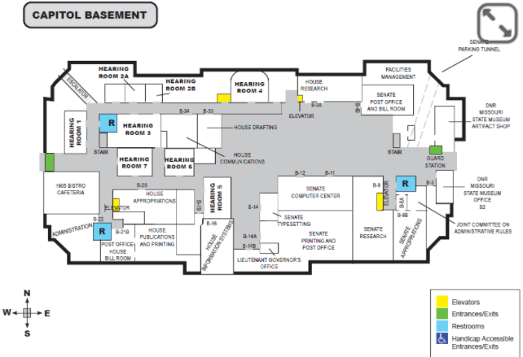

Slide 6
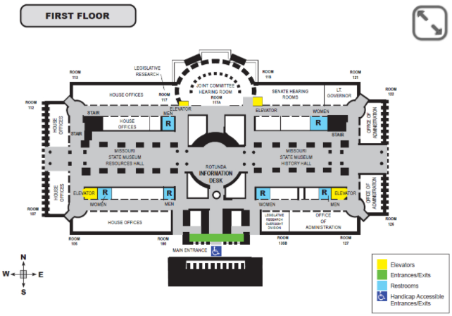

Slide 7
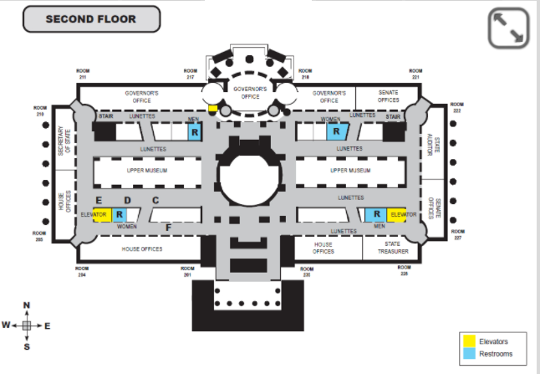

Slide 8
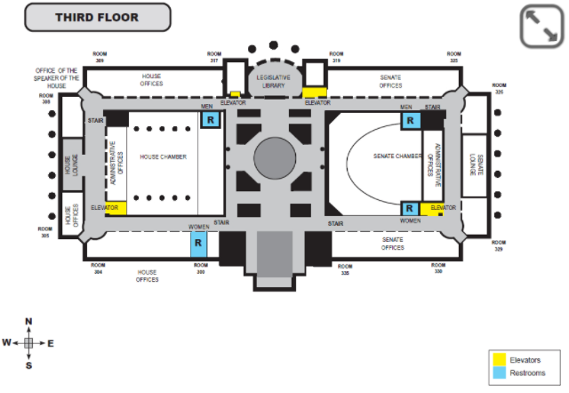

Slide 9
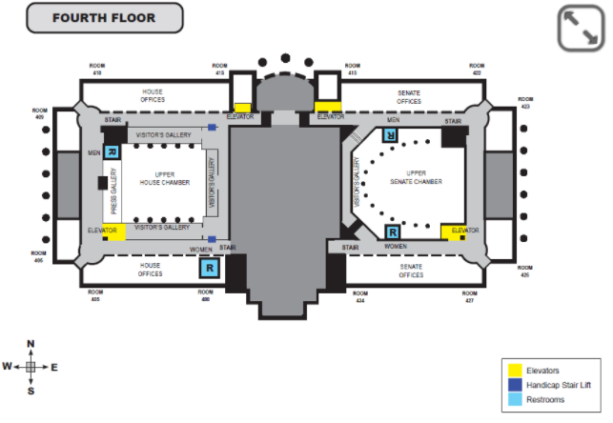

Slide 10
Moving around the Capitol building
Elevators
Southwest and Southeast corners
Northside Center
Bathrooms
Men’s and Women’s on opposite corners
General Layout
Senate, Senate Hearing Rooms and Administrative Offices East Half (generally)
House West Half
Cafeteria and House Hearing Rooms in Basement

Slide 11
Legislator’s Offices
House
Single Suite Offices for Leadership
Chief of Staff
Legislative Assistants
Interns
Single and Multi-Suite Offices for Members
Legislative Assistant
Intern
Senate
Single Suite Offices
Chief of Staff
Legislative Assistants
Interns

Slide 12
House and Senate Chamber Rules
Cell phones on silent
No phone conversations allowed
Conversations are to be kept at a whisper
No reaction from gallery (unless in a group being recognized on the floor)
No pictures allowed while in session
No food or beverages
Keep feet off railing and do not set anything on the railing

Slide 13
Message Points for Legislators
Rule #1 – Do not get into a policy discussion
Do you want to be a more effective representative for your constituents?
DC does too much, spends too much and stays there too long.
DC doesn’t represent us anymore.
DC will never limit their own power nor, return decision making back to the state legislatures or the people.
The Convention of States resolution allows proposals to:
Limit the size, scope and jurisdiction of the federal government.
Discuss term limits for federal officials.
Restore fiscal restraints.
Missouri passed the Convention of States resolution. We are working on Missouri’s Commissioner Selection Bill this session. Sponsors – House: Rep. Curtis Trent, Senate: Sen. Eric Burlison
“I am not sure but, I’ll find out and get back to you.” is an okay answer.

Slide 14
Legal Concerns
Convention of States Action is a 501(c)(4) non-profit
What we can do:
Lobby for or against legislation (Influencing the outcome of legislative action)
Educate about the Constitution, First Principles and History
Get Out the Vote efforts
Neutral and non-partisan politically
What we cannot do:
Cannot endorse candidates
Campaigning (as an organization) is heavily regulated
Cannot encourage others to vote a certain way
A candidate can endorse the COSP. The COSP cannot endorse a candidate

Slide 15
Thank you!!

