Slide 1

Capitol Strike Force Team
Spring 2020

Slide 2
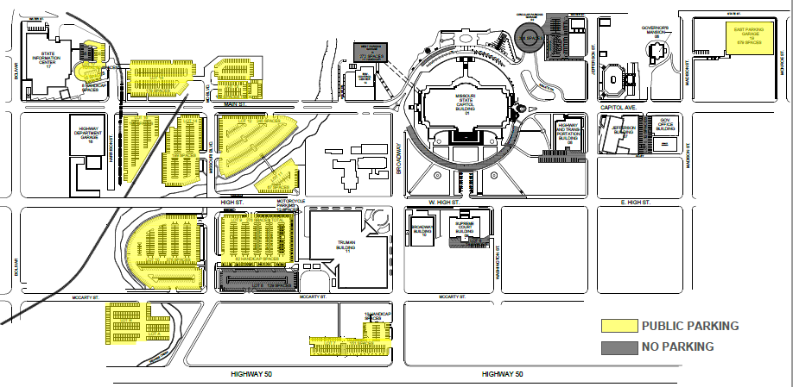
Capitol Area Parking Map

Slide 3


Slide 4
Entering the Capitol
Parking
  Capitol Plaza Lots
  Madison Street Garage
  Handicapped accessible parking in North Circle
  Traffic moves counterclockwise around Capitol building
Entrances
  South and West entrances open
  ADA accessible entrance East Garage
  All entrances have security and public must pass through magnetometers

Slide 5
Moving around the Capitol building
Elevators
  Southwest and Northeast corners
  Northside Center
Bathrooms
  Men’s Southwest and Northeast
  Women’s Northwest and Southeast
General Layout
  Senate, Senate Hearing Rooms and Administrative Offices East Half (generally)
  House West Half
  Cafeteria and House Hearing Rooms in Basement

Slide 6
Legislator’s Offices
House
  Single Suite Offices for Leadership
    Chief of Staff
    Legislative Assistant
    Interns
  Single and Multi-Suite Offices for Members
    Legislative Assistant
    Intern
Senate
  Single Suite Offices
    Chief of Staff
    Legislative Assistants
    Interns

Slide 7
House and Senate Chamber Rules
Cell phones on silent
No phone conversations allowed
Conversations are to be kept at a whisper
No reaction from gallery (unless in a group being recognized on the floor)
No pictures allowed while in session
No food or beverages
Keep feet off railing and do not set anything on the railing

Slide 8
Message Points for Legislators
Rule #1 – Do not get into a policy discussion
Do you want to be a more effective representative for your constituents?
DC does too much, spends too much and stays there too long.
DC doesn’t represent us anymore.
DC will never limit their own power nor, return decision making back to the state legislature or the people.
The Convention of States resolution allows proposals to:
  Limit the size, scope and jurisdiction of the federal government.
  Discuss term limits for federal officials.
  Restore fiscal restraints.
Ask for support of HCR__/SCR__, the Commissioner Selection Resolution.
“I am not sure but, I’ll find out and get back to you.” is an okay answer.

